Slide 1
Custom Reporting
Guardium, Inc.
230 Third Avenue
Waltham, MA 02451
USA
www.guardium.com

Slide 2

Custom Reporting Topics
Process Overview – Three Steps to Create Reports
About Data Domains
Creating a Query
Creating a Report Based on a Query
Placing a Report on a Portal Page

Slide 3
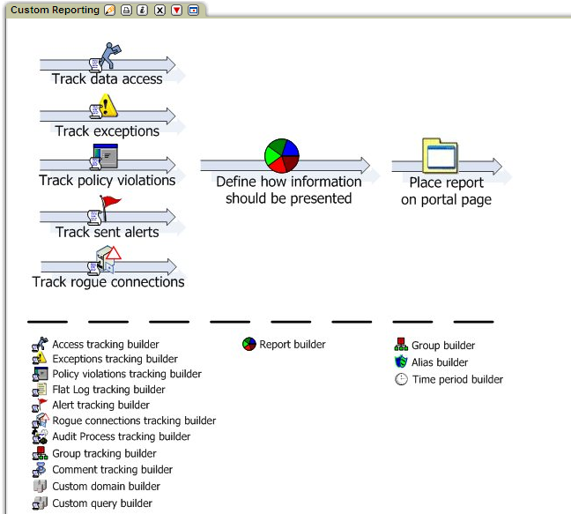
Creating a Report
1 2 3
Define a query
Create a report
Place report on page

Slide 4
Standard Query Domains
Access: All of the client/server, session, and SQL requests
Alerts: All alerts generated and sent by Guardium
Audit Process: The execution of audit processes and the distribution of results
Auto-discovery: Database auto-discovery activity
Comment: User defined comments for various Guardium components
Custom: User defined domains can define tables uploaded to Guardium
Exceptions: All of the exceptions and exception-related data
Group: Membership in Guardium groups
Installed Policy: Describes policy rules and general parameters
Policy Violations: All policy violation data, for all violations of the policy detected by the Guardium inspection engines.
Rogue Connections: (Unix non-K-Tap only) Local database server processes that have circumvented S-TAP to connect to the database via shared memory, named pipes, or other non-standard means

Slide 5
Administrator Query Domains
By default, these domains are available to admin role users only.
Aggregation/Archive: Aggregation and archiving activity
Application: Connection and session data for non-Guardium applications
Flat Log: Flat log processing activity
Guardium Activity: Details of all modifications to any Guardium entity, such as a report or query definition
Guardium Logins: All Guardium user login and logout information
Security Assessment Result: Results of vulnerability assessment processes
Sniffer Buffer: Inspection engine statistics
User/Role/Application: Who has access to which Guardium applications
Value Change: Changes tracked by trigger-based change tracking application

Slide 6
Optional Product Query Domains
These domains are available only with the associated optional products.
Change Audit System (Optional Product)
CAS Changes – All changes detected by CAS
CAS Config – CAS instance configurations
CAS Host History – Changes to agents on hosts
CAS Templates – Contents of templates
Classifier (Optional Product)
Classifier Results – Process executions and results

Slide 7
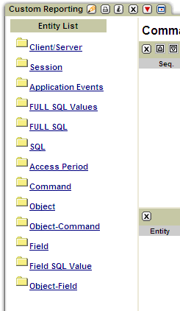
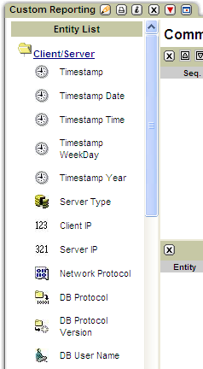
What’s in a domain?
Entities… containing attributes

Slide 8
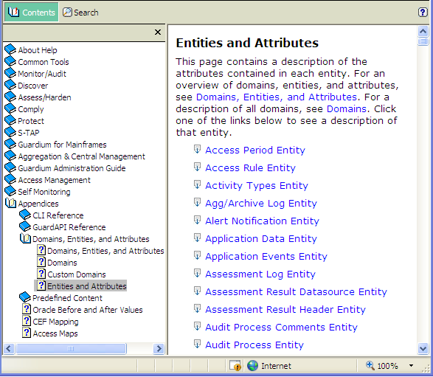
To find entity and attribute definitions…
Click the help
button.
Navigate to the Entities and Attributes topic.
Select an entity.

Slide 9
Data Access Domain Entities
Client/Server: Client and database server connection info (IPs, OS, etc.)
Session: Database name, session start and end times
Application Events: Events from the Guardium API
Full SQL Values: Values logged separately for faster search
Full SQL: The full SQL string (with values)
SQL: The SQL request (no values)
Access Period: When – Logging granularity
Command: SQL command
Object: SQL object
Object-Command: Command detected in object
Field: Field
Field SQL Value: Field value logged separately for faster search
Object-Field: Field detected in object

Slide 10
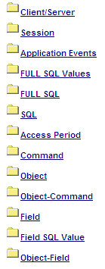
Data Access Domain Entity Hierarchy
There are six levels in the entity hierarchy for this domain.
Each client/server connection has one or more sessions.
Each session has one or more requests.
Each request has some combination of these entities.
Each request may contain commands.
Each command may contain objects.
Each object may contain these entities.

Slide 11
The Main Entity Determines…
What a record in the report represents
What the query counts
What attribute values and aggregates (Count, Minimum, Maximum, Average) will be available
What drill downs are available

Slide 12
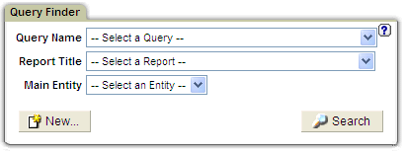
Begin a Query Definition
1. Navigate to the Custom Reports application:
  Click the Monitor/Audit tab.
  Click the Build Reports tab.
2. Click Track data access to open the Query Finder:
3. Click the New button to define a new query.

Slide 13
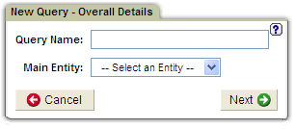
Name the Query and Select the Main Entity
1. Enter a query name.
2. Select Command from the Main Entity list.
3. Click the Next button.

Slide 14
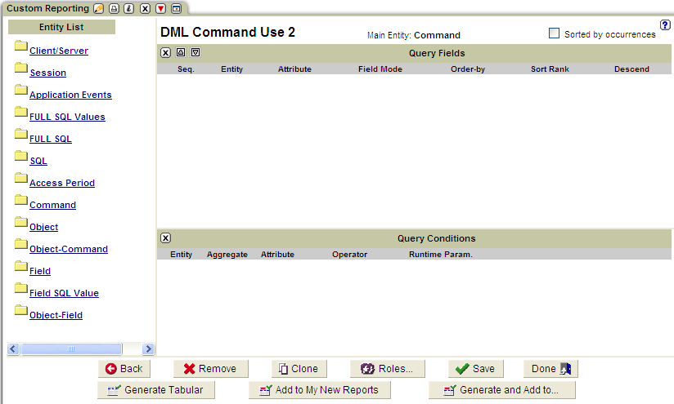
Query Definition Panel

Slide 15
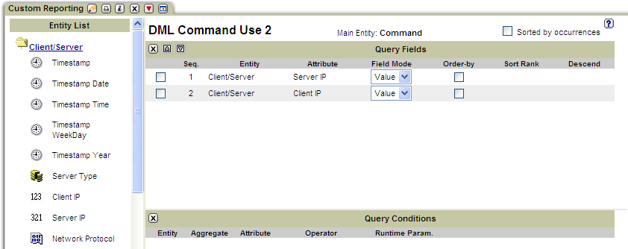
Identify Fields to Be Listed
Open the Client/Server entity.
Add fields to the Query Fields list.
Then add SQL Verb field from the Command entity (not shown).

Slide 16
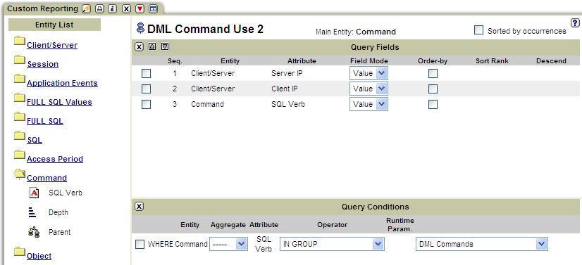
Add a Query Condition
Add SQL Verb to the Query Conditions list.
Select IN GROUP from the list of Operators.
Select DML Commands from the list of groups.

Slide 17
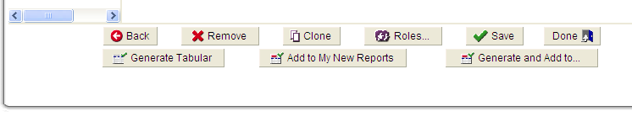
Generate the Report
Click the Save button to save the query definition.
Click the Generate Tabular button to define a default tabular report based on this query.
Click the Add to My New Reports button to add the report to the default layout page for new reports.

Slide 18
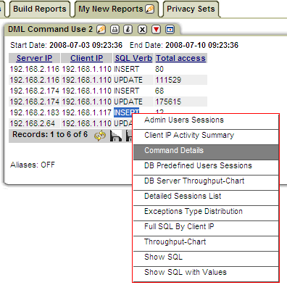
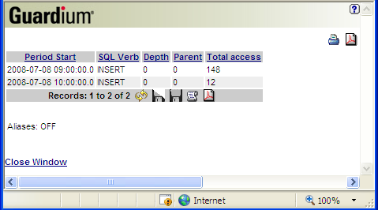
The Results
Drill down to display the Command Details report for the Insert commands…

Slide 19
Guardium Reports
Define a Query
Create a Tabular Report
Create Graphical Report
Viewing The Results
Download The Result
Drill Downs
Aliases

Slide 20
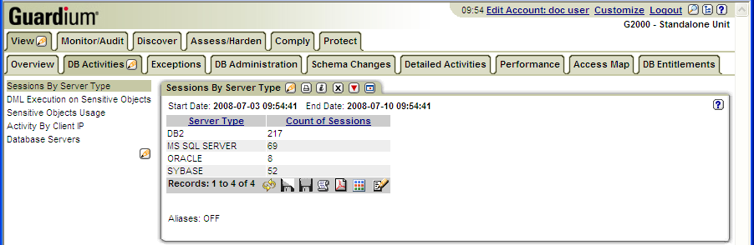
Tabular Report Results

Slide 21
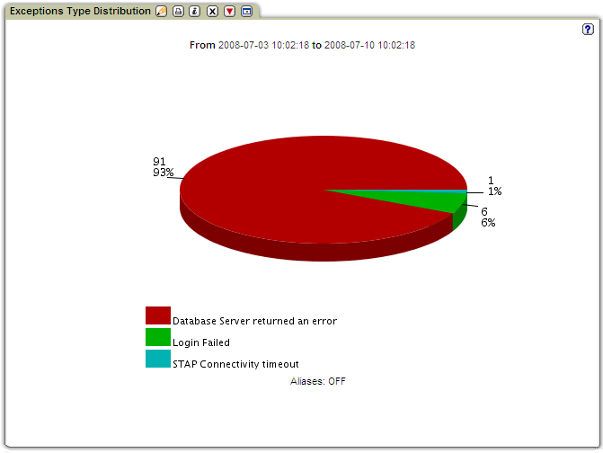
Graphical Report Results

Slide 22
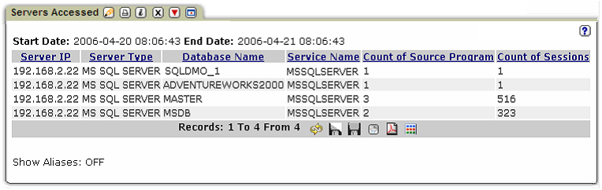
Displaying Tree Maps

Slide 23
Define A Report
Report Title
Column Titles
Parameters
Tabular / Graphical
Monitor
Refresh Rate
Chart Type and Presentation Parameters

Slide 24
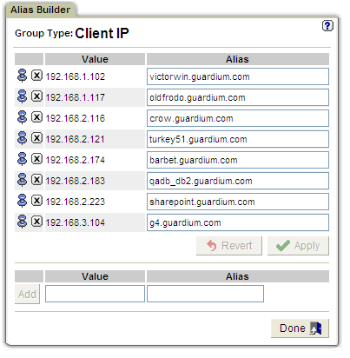
Additional Components
Automatic IP-to-Hostname Aliasing
Discretionary Aliasing
Groups
Portlets, Page, Portal – Portlets can be displayed within a page, iconified to temporarily take up less screen real estate, maximized to populate a full browser window, or removed from a page altogether – using the toolbar within the portlet. Portlets and pages make up the portal.
Relative Date Picker – For example:
NOW –n MONTH (no plurals allowed)
Clone – Start from existing definitions

Slide 25
Aliases
Alias Definition
Use Aliases in a report
Quick Aliases Definition
IP to Host Name

Slide 26
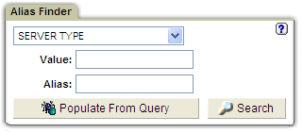
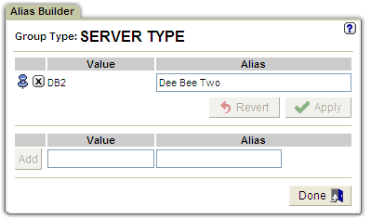

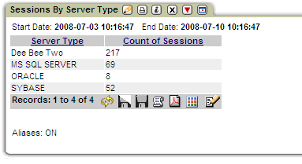
Alias Definition from Alias Builder

Slide 27
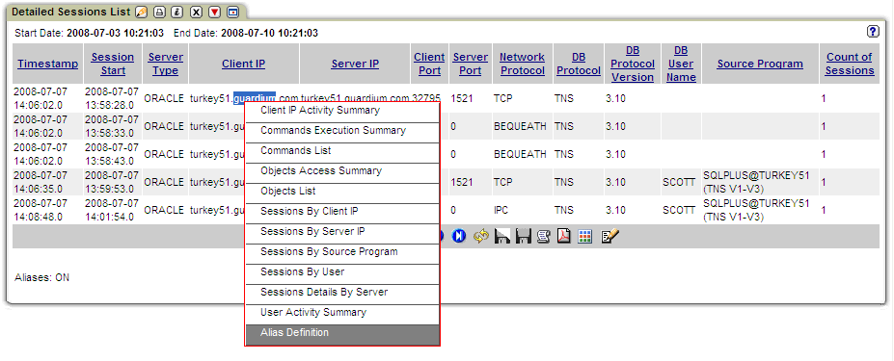
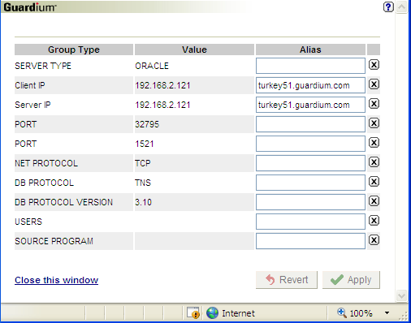
Alias Quick Definition

Slide 28
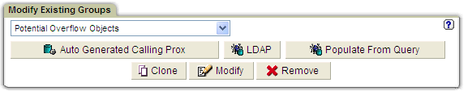
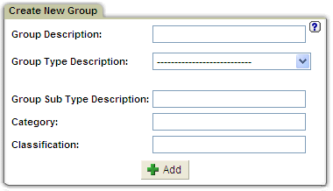
Groups
Create and modify groups
Use groups in a query conditions (is member of)
Use groups for grouping report data
Pre-defined Groups

Slide 29
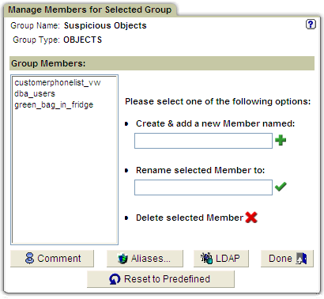
Group Members Definition

Slide 30
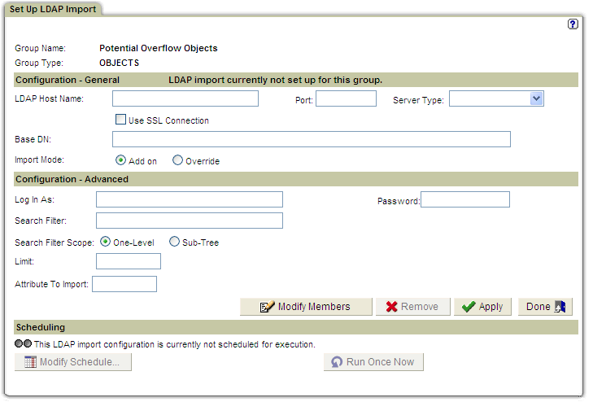
Group Members from LDAP

Slide 31
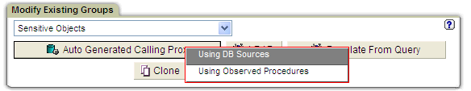
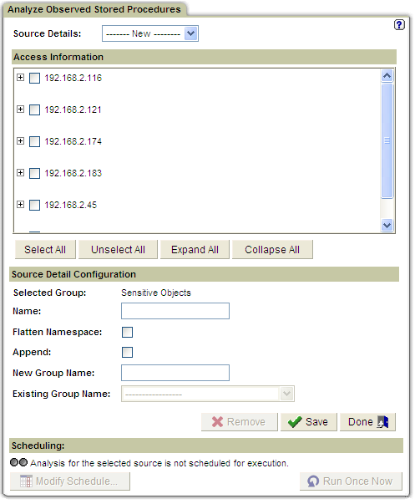
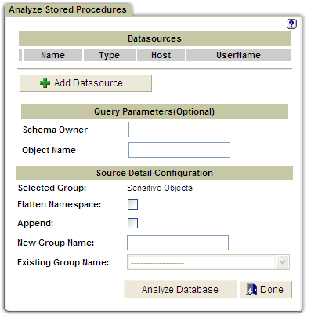
Group Members from Stored Procedures

Slide 32
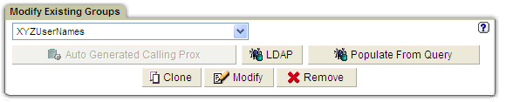
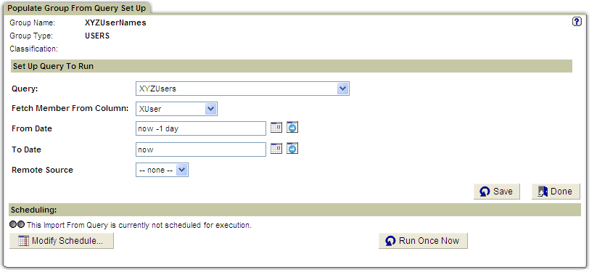
Group Members from Query

Slide 33
Time Periods

Slide 34

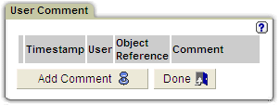
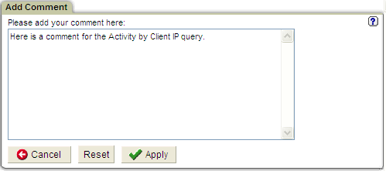
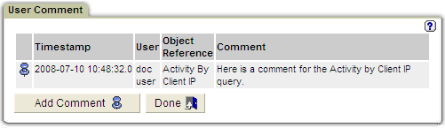
User Comments
Add User Comments to most types of definitions
or to Audit Process results.

Slide 35
Summary
Query Definition
  Drag and Drop builder
Use the Query
  Reports
  Alerts
Customized Reports
  Parameters
  Look and Feel

